Slide 1
My Weather App
Jerome Anaeki
Student ID: 001-81-0698

Slide 2
Introduction
This app displays the current weather of any city in the world. It includes a picture depicting the climate.
The weather governs our lives in one way or another.
Weather conditions can affect the way we dress, traffic on the roads, etc.
In areas where the weather changes constantly and can be unpredictable, My Weather App will be very useful so that you stay aware of the conditions

Slide 3
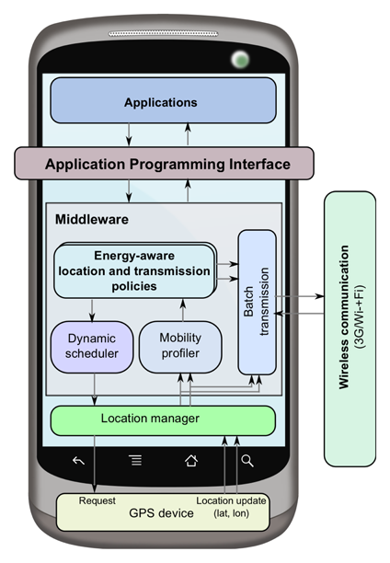
Overall Design Architecture
The application includes two packages that are necessary for operation:
Data for data objects in the Yahoo Weather API
Service to communicate with Java API and return data

Slide 4
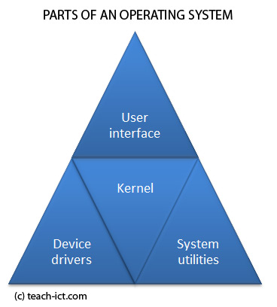
OS-Level Functionalities
getDelegate()
openConnection()
getResources()

